Slide 1
Real-time Operating Systems

Slide 2
OS Requirements
Mechanisms and services to perform:
  real-time scheduling
  resource management
Predictabilty and accountability of internal OS services
V1.4
Real-Time Operating Systems

Slide 3
Desirable OS features
Modular and extensible
Small kernel (especially for embedded systems)
Certification for safety critical systems
Simple
Microkernel based (minimally scheduling synchronisation and interrupt handling)
V1.4
Real-Time Operating Systems

Slide 4
Real-time POSIX
Real-time and thread extensions of the POSIX Application Programming Interface
POSIX – Portable Operating System Interface (IEEE Standard)
V1.4
Real-Time Operating Systems

Slide 5
Threads
Normally implements a job
  Basic unit of work handled by a scheduler
Thread creation:
  Allocated memory
  Loads code to be executed into memory
  Instantiates a Thread Control Block
V1.4
Real-Time Operating Systems

Slide 6
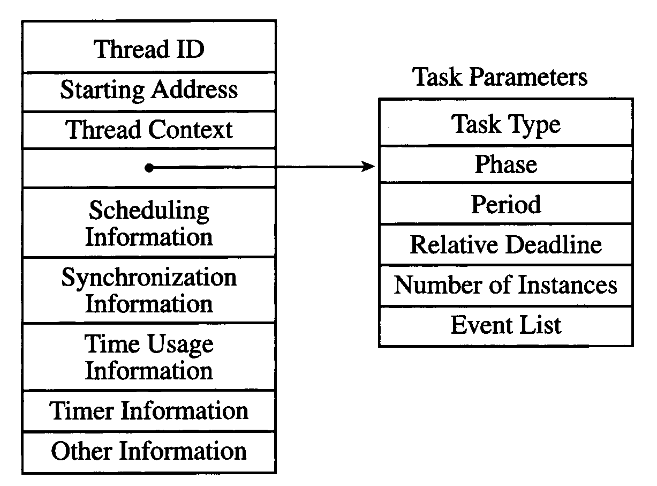
Thread Control Block
V1.4
Real-Time Operating Systems

Slide 7
Periodic Threads
Inefficient to create and destroy a thread every period
Kernel keeps the thread in memory and reinitialises the thread each time it runs
Kernel keeps track of time and releases (moves to read queue) the thread at the beginning of each period
V1.4
Real-Time Operating Systems

Slide 8
Periodic Threads
Most commercial operating systems do not support periodic threads
However, a thread can put itself to sleep, awaken and re-initialise to emulate a periodic thread.
V1.4
Real-Time Operating Systems

Slide 9
Additional Threads
Aperiodic and sporadic threads can be used to run aperiodic and sporadic jobs
Server threads can be used to implement scheduler policies such as a bandwidth preserving server
V1.4
Real-Time Operating Systems

Slide 10
Major States (1)
Sleeping - Aperiodic, sporadic or server thread is created and put into the sleeping state immediately. It is released upon an externel event of a particular type
Ready - A thread enters the ready state after it is released or when it is preempted
Executing – A thread is currently executing
V1.4
Real-Time Operating Systems

Slide 11
Major States (2)
Suspended (or Blocked) – A thread that has been released and is yet to complete enters the suspended state. Reasons for a blocked thread:
  resource access
  synchronisation with another thread
  Awaiting budget
  Awaiting I/O completion
V1.4
Real-Time Operating Systems

Slide 12
Major States (3)
Terminated – A thread that will not execute again will enter the terminated state. A terminated thread can be deleted from the system
V1.4
Real-Time Operating Systems

Slide 13
The Kernel
Reasons the kernel takes control:
  Responding to a system call
  Scheduling and servicing timers
  handle external interrupts
V1.4
Real-Time Operating Systems

Slide 14
The Kernel (2)
Many embedded operating systems do not provide memory protection. Kernel and user code run in the same address space
  applications must be trustworthy
  reduce overhead
V1.4
Real-Time Operating Systems

Slide 15
The Kernel (3)
Timers
  A software timer is an object used to to keep track of time
  A clock is a hardware device that contains a counter. At any time the content of the counter gives a representation of the current time
  Support for system wide timers and threads for individual thread timers
V1.4
Real-Time Operating Systems

Slide 16
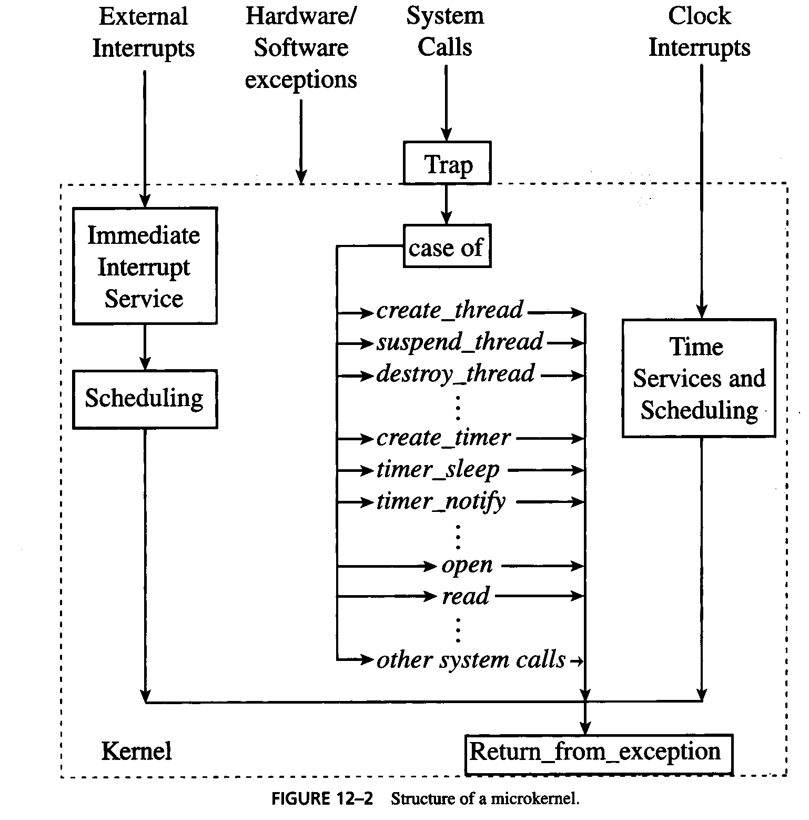
Structure of a microkernel
V1.4
Real-Time Operating Systems

Slide 17
Time Services and Scheduling (1)
The scheduler is a central part of the kernel
  executes periodically
  executes when state of any thread changes
In practice the scheduler may only run at regular intervals e.g. when a clock interrupt occurs. This has implications for many schedules including priority driven:
  Jobs may be ready to run but may not have been put on the ready queue
  Period of clock interrupts is called the tick size (typically 10ms)
V1.4
Real-Time Operating Systems

Slide 18
Time Services and Scheduling (2)
At every clock interrupt the kernel does the following:
  Process timer events – kernel checks the queue of pending timer expiration times to see which have expired since the last tick. And performs any necessary action e.g. moving a thread to the ready queue
  Updates execution budget e.g. reduce the time budget of each round robin scheduled task by the tick size and moves to suspended queue if exhausted
  Updates the ready queue
  Kernel housekeeping
V1.4
Real-Time Operating Systems

Slide 19
Time Services and Scheduling (3)
Responsiveness of the system depends on the tick size
Trade off between tick size and overhead
Systems that use round robin scheduling well suited to periodic execution of the scheduler (time-based scheduling)
However, many systems will use time-based scheduling in conjunction with event based scheduling
V1.4
Real-Time Operating Systems

Slide 20
External Interrupts
Notify an application of some external state change
Time required to handle interrupt varies considerably e.g. if DMA used or not
  Up to tens of milliseconds for disk/network devices
Interrupts may be split into two phases
  Immediate interrupt service
  Scheduled interrupt service
V1.4
Real-Time Operating Systems

Slide 21
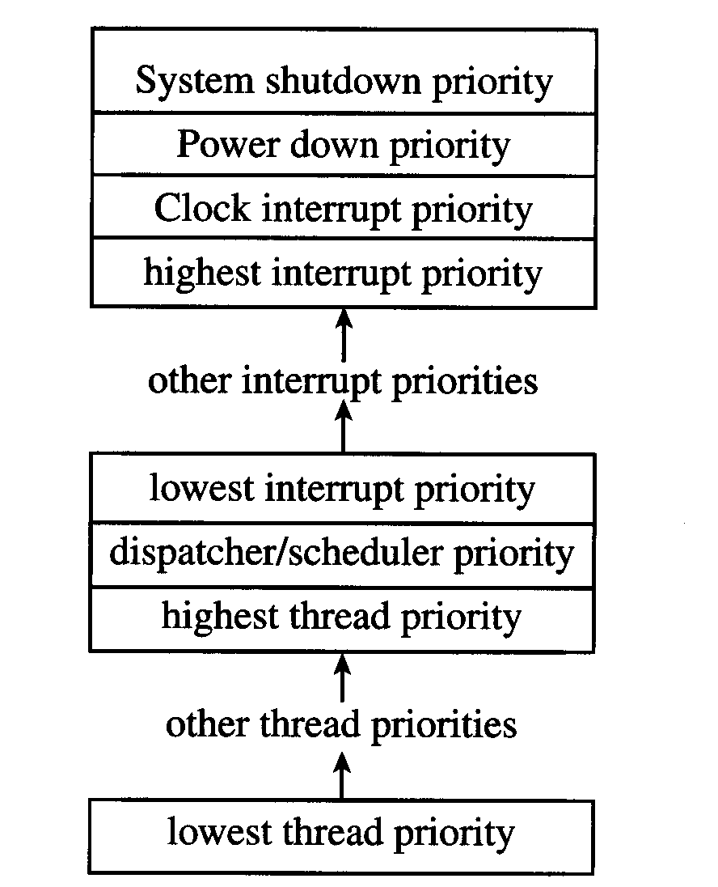
Interrupt Hirarchry
V1.4
Real-Time Operating Systems

Slide 22
Immediate Interrupt Service
Bring processor to a consistent state – finish instruction, flush pipeline, jump to interrupt dispatcher
Disable external interrupts
Service higher priority interrupts if necessary
Save context of interrupted thread
Start the Immediate Interrupt service routine
Note a barebone implementation of a RT kernel may require more work on the developers part to processs interrupts
V1.4
Real-Time Operating Systems

Slide 23
Scheduled Interrupt Service
Premptable
Executed by kernel threads but possibly at a user level priority with suitable priority inheritance
May run as an aperiodic or sporadic task
V1.4
Real-Time Operating Systems

Slide 24
Time Services (1)
Clocks Device contains:
  a counter
  timer queue
  interrupt handler
Counter monotonically increases when triggered by a precise sequence of pulses
Timer queue contains a list of pending expiration time of timers bound to the clock
V1.4
Real-Time Operating Systems

Slide 25
Time Services (2)
Resolution
  hardware clocks have a resolution of nanoseconds
  clocks available to applications normally have a resolutions of hundreds of microseconds or milliseconds
V1.4
Real-Time Operating Systems

Slide 26
Time Services (3)
Software Clock (implemented by kernel)
  clock device periodically interrupts the software clock and the time is updated
  resolution of software clock depends on the frequency of interrupts
A thread gets the current time by calling the POSIX function clock_gettime(id), where id is the clock to be read
V1.4
Real-Time Operating Systems

Slide 27
Time Services (4)
Multiple clocks may be necessary e.g.
  10mS tick clock may be too course to time specific events
  It is convenient if the clock periods are related e.g. the tick clock is updated once ever x interrupts of the higher frequency time-service interrupts
  software clocks with a resolution of nano-seconds are not meaninful
V1.4
Real-Time Operating Systems

Slide 28
Time Services (5)
High resolution clocks
  map a hardware clock directly into an applications address space e.g. a monotonically increasing counter that increments every few nano-seconds (available on Pentiums)
  not generally portable
V1.4
Real-Time Operating Systems

Slide 29
Time Services (6)
Timers and Timer functions
  RT POSIX complient systems and others allow a thread or process to to have its own timer
  Typically the timer contain:
    expiration time (absolute or relative)
    handler routine to be called when the timer expires
  Timers may be cancelled
  Timers may be one-shot or periodic
V1.4
Real-Time Operating Systems

Slide 30
Time Services (7)
Asynchronous timer functions
  For example, Watchdog timers (see article on server)
    Supported by VxWorks
    wdStart(timerID, relativeExpirationTime, function to call, function argument)
    wdCancel – cancels the timer before it expires
  Could be used to monitor the deadline of a sporadic task
V1.4
Real-Time Operating Systems

Slide 31
Time Services (8)
Synchronous Timer Functions
  timer_sleep () Real-time MACH
  nano_sleep() Real-time Posix
  Thread suspends until timer expires
V1.4
Real-Time Operating Systems

Slide 32
Time Services (9)
Timer Accuracy - Difference between absolute time specified by a thread and the actual time something happens, source of error include:
  Frequency at which timer expirations are checked
  Order that events are acted upon in the kernel. Some OS’s process the latest expiration time first
  Time to process the timer event
V1.4
Real-Time Operating Systems

Slide 33
Time Services (10)
Release-time Jitters of Periodic Tasks –
Factors control the starting time of the first job
  Thread pre-empted and not scheduled until later
  Creation time of the timer – if this is small (<1mS) it can be ignored
  The overwhelming factor is the time the thread is blocked thus the anticipated starting time t + 10, is in fact the earliest start time.
V1.4
Real-Time Operating Systems

Slide 34
Commercial Real-Time Operating Systems

Slide 35
LynxOS
Microkernel (28KB)
  Scheduling, interrupt dispatch, synchronization
Supports multithreaded Kernel Plug-Ins
  I/O, File System, TCP/IP, streams, sockets
Can be configured as a self hosted system for development and for protection supports hardware memory management
API’s modelled on UNIX system calls
Split Interrupt Handling
  Interrupt handler and kernel thread
V1.4
Real-Time Operating Systems

Slide 36
pSOS (1)
Object Oriented, Modular
POSIX real-time extension layer
pSOS+
  Preemptive, multi-tasking, single processor
pSOS+m
  Distributed multiprocessor kernel
  adds interprocessor communication and synchronisation
V1.4
Real-Time Operating Systems

Slide 37
pSOS (2)
Classes include
  tasks
  memory regions and partitions
  Message queues
  Semaphores
V1.4
Real-Time Operating Systems

Slide 38
pSOS (3)
Device drivers run outside of the kernel giving developers complete control
When an interrupt occurs the processor jumps directly to the service routine via a vector table
Tasks are allocated to a physical contiguous block of memory
Used on the Iridium system of communication satellites
V1.4
Real-Time Operating Systems

Slide 39
QNX/Neutrino
Multiprocessor operating system suited to high-end networked Symmetric Micro Processing machines
Microkernel (12KB) based providing essential thread and real-time services
Resource managers supply other OS functionality
QNX implements POSIX message queues outside the kernel and QNX message passing within the kernel
Supports atomic add/subtract and bit set/clear
V1.4
Real-Time Operating Systems

Slide 40
VRTX (1)
VRTXsa – designed for performance
  POSIX complient library
  priority inheritance
  multitask support
  system calls deterministic and preemptable
VRTXmc – optimised for power consumption and ROM/RAM sizes
  target hand held devices (4-8 KB rom, 1KB ram)
V1.4
Real-Time Operating Systems

Slide 41
VRTX (2)
First RTOS certified by the FAA
  FAA RTCS/DO-178B Level A for software whose failure would cause or contribute to a catastrophic failure of the aircraft
  Conformance certification requires 100% code coverage in testing
Provides hooks for extensibility
Has own API in addition to POSIX
V1.4
Real-Time Operating Systems

Slide 42
VxWorks (1)
Famous for Mars landing in 1997 where system repeatedly reset itself. Root cause was classic uncontrolled priority inversion problem
  Priority inheritance mechanism was disabled. Enabling it fixed the problem
  Prolonged blocking caused a high priority task to miss its deadline, resulting in a reset.
  Reset behaviour was observed once during testing but deemed infrequent enough not to warrant concern
V1.4
Real-Time Operating Systems

Slide 43
VxWorks (2)
  Lessons learned:
    Leave in instrumentation code for testing and debugging deployed systems
    Cannot rely on testing to determine if tasks can complete on time or how often a task might be late
    Follow principle of maximum paranoia
V1.4
Real-Time Operating Systems

Slide 44
VxWorks (3)
VxWork uses global parameters to:
  enable/disable memory protection
  enable/disable priority inheritance
  in the case of Pathfinder priority inheritance was disabled
VxWorks is a monolithic system
Provides most POSIX RT extensions but is not UNIX based
V1.4
Real-Time Operating Systems

